Slide 1




Cincy Deliver 2026 Sponsors
Diamond
Platinum
Gold

Slide 2
CINCY DELIVER 2026 · JULY 24, 2026
Agents Are Products, Not Prompts
Operationalizing AI-assisted development beyond hero developers
The discipline we already apply to code — version control, review, testing, lifecycle, deprecation — is exactly what agents need.
SHAWN WALLACE
Principal Architect · Centric Consulting
Notes:
[~30 sec] Room-filler slide. Quick intro: name, Principal Architect at Centric. One sentence on the promise: by the end you'll have a maturity model to locate your team and a repeatable process for building agents you can maintain, test, and hand off.
Don't read the quote — it's the thesis; say it in your own words. Then go straight into the story: 'Let me tell you about an engineer I worked with.'

Slide 3
THE COLD OPEN
One engineer's practice worked — for one person
Built alone
Inherited, not understood
Adoption stalled
No design review, no team input — refined solo until it worked exactly right. Genuinely good work.
The team got the assets, not the judgment. Nobody had shaped the constraints or earned the trust.
Nobody trusted output they hadn't helped build. The work was good — the practice wasn't shared.
The model didn't fail — the practice was never designed to be handed off.
Promise: leave able to build agents you can maintain, test, hand off, and change without fear.
Agents Are Products, Not Prompts | Cincy Deliver 2026
2
Notes:
[~3 min] Tell it as a STORY, not a slide walk. Anonymized but real: an engineer built out AI-assisted agents completely solo — no design review, no team input — refined them until they worked exactly the way they wanted. Emphasize: genuinely good work. This is not a story about a bad engineer.
Then the hand-off: the team inherited the assets, not the judgment. Nobody had shaped the constraints, nobody understood the scoping, nobody trusted output they hadn't helped build. Adoption stalled.
Land the reframe slowly — it's the sentence the whole talk hangs on: the model didn't fail; the practice was never designed to be handed off. A hero's workflow, not an engineered artifact.
Make the promise (blue line), then transition: 'Why does this keep happening? Because of what AI is actually good at.'

Slide 4
WHY HERO DEVELOPERS DON'T SCALE
AI is good at code. Not software.
Code vs. system
The split no one names
AI accelerates boilerplate and execution. Structure, boundaries, and “is it done / is it correct” are still human judgment.
AI amplifies seniors with taste — and quietly leaves juniors shipping code that looks senior without understanding it.
The hero trap
Real wishful thinking
If only a few seniors know when to trust the output, that judgment is trapped in their heads. It doesn't scale or develop the next generation.
Hoping this works itself out. The alternative: operationalize — encode the judgment into artifacts the whole team uses.
Agents Are Products, Not Prompts | Cincy Deliver 2026
3
Notes:
[~5 min] From the 'Wishful Thinking?' blog post. Walk the four cards in reading order.
Code vs. system: AI is a real accelerant for boilerplate and execution. But software is a set of decisions — structure, boundaries, tradeoffs, 'is it done / is it correct' — and that judgment is still human.
The split no one names: AI amplifies seniors with taste and quietly leaves juniors behind — a junior can now ship code that LOOKS senior without understanding it. (Preceptorship problem: heroics don't develop the next generation.)
The hero trap: if the practice works only because a few seniors know when to trust the output, you don't have a practice — you have individual heroics, trapped in heads.
Real wishful thinking: hoping this works itself out. The alternative is to operationalize — encode the judgment into engineered artifacts the whole team uses. Transition: 'Here's a map for that journey.'

Slide 5
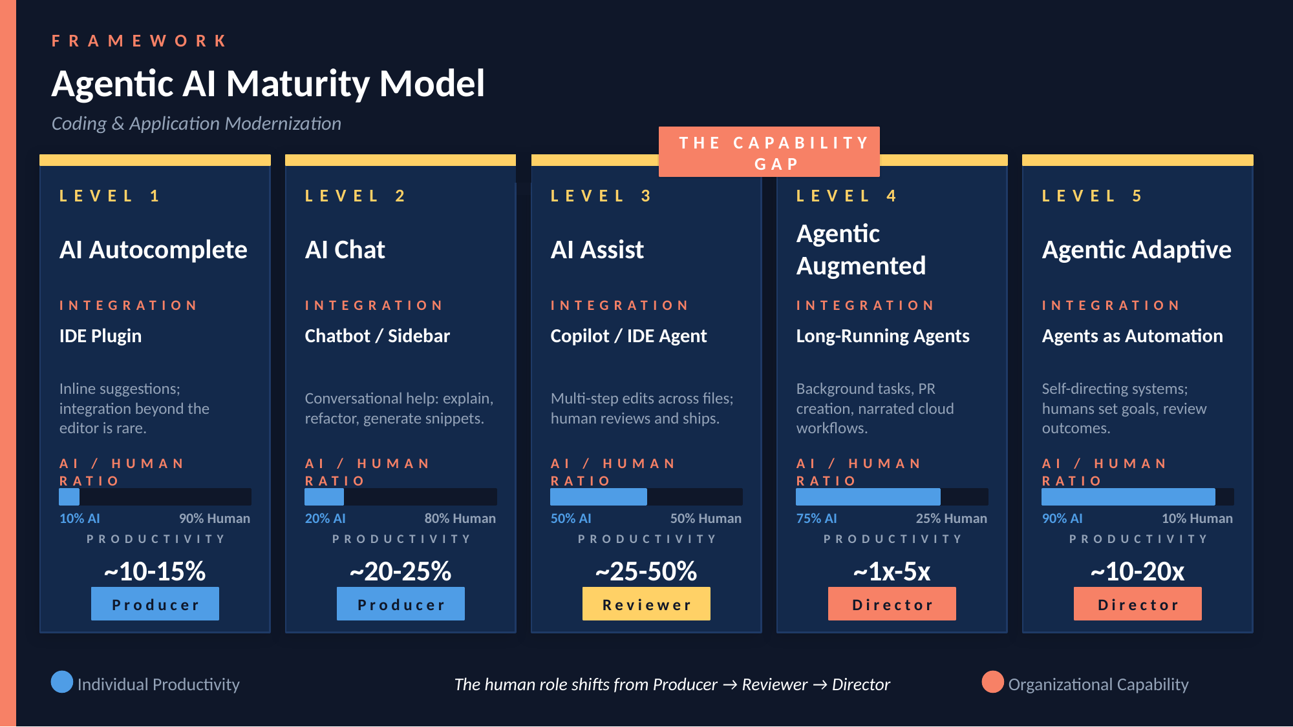
Notes:
[~4 min] This is YOUR model — own it. Walk L1→L5 briskly; trace two things while climbing: the AI/human ratio rising, and the human role shifting Producer → Reviewer → Director.
SPEND THE TIME ON THE GAP (badge sits between L3 and L4): the hard jump from 'AI assists, a human ships every change' to 'agents run long-running work and a human directs.' You cannot cross it with prompted heroics — crossing it REQUIRES engineered, governed agents. This gap is the reason for this talk.
Tie to the cold open: Producer→Reviewer→Director IS the move off hero-dependence — humans stop being the bottleneck producer and start directing an engineered system.
Position the rest of the talk: everything from here — design rigor, the decomposition, the SDLC roster, governance — is how you cross the gap into L4–L5.

Slide 6
PROMPT ENGINEERING ≠ SOFTWARE ENGINEERING
One prompt away from “working” — so teams stop there
Inconsistent
Unmaintainable
Brittle
Same input, different behavior.
One giant prompt — no named parts.
Requirements shift, it quietly breaks.
Common pitfalls: task-based agents · vague instructions · over-scoping · no testing · set-and-forget
Agents Are Products, Not Prompts | Cincy Deliver 2026
5
Notes:
[~4 min] The trap that keeps teams below the gap: an agent is one text box away from 'working,' so they stop there — no source control, no tests, no review. NO TRUST
Three symptoms of a prompted-not-designed agent: inconsistent (same input, different behavior), unmaintainable (one giant prompt, no named parts), brittle (requirements shift, it quietly breaks). Ask the room: 'Sound familiar?' — usually gets knowing laughs.
Pitfalls strip at the bottom (from the workshop): task-based agents, vague instructions, over-scoping, no testing, set-and-forget. Transition: 'So what does actually engineering one look like?'

Slide 7
THE FRAMEWORK FOR ENGINEERING AN AGENT
Prompts → Instructions → Skills → Agents
Prompts
Instructions
Skills
Agents
One-off, chat-invoked, no tools
Always-on guardrails
On-demand knowledge, /skill
Specialists with tools + workflow
The same ladder as the maturity model — agents are the engineered end.
Agents Are Products, Not Prompts | Cincy Deliver 2026
6
Notes:
[~1–2 min — don't linger] The capability hierarchy: Prompts (one-off, no tools) → Instructions (always-on guardrails) → Skills (on-demand knowledge) → Agents (specialists with tools + workflow).
Point: it's the same ladder as the maturity model — agents are the engineered end. This frames the next two slides: what an agent is made of, and how you design one.
It’s all about context for a lot of reasons…

Slide 8
DESIGN RIGOR APPLIES HERE TOO
Right layer compounds. Wrong layer costs you.
Instructions
Skills
Agents
Right — small, non-negotiable, loaded on every task.
Wrong — bloat it and every call gets slower and vaguer.
Right — real procedure, loaded only when triggered.
Wrong — bury it and it never fires when it's needed.
Right — enough scope to justify its own context and tools.
Wrong — spin one up too small and it's dead weight to maintain.
Same rigor as any interface: get the layer right and it compounds — get it wrong and it costs you.
Agents Are Products, Not Prompts | Cincy Deliver 2026
7
Notes:
[~1 min] The question under the hierarchy: where does new information actually go? Instructions are small and non-negotiable — every single task pays their cost, so keep them lean. Skills are on-demand — real procedure, but only loaded when triggered, so detail there is nearly free. Agents are a fully separate context — right when the scope justifies its own tools and workflow, wrong when you spin one up for something a skill could’ve handled.
Land the transition line: ‘This is a design decision, not a dumping ground — same rigor as any other interface.’ That rigor is exactly what the next two slides make concrete: the Agent Components model, then the design process itself.
Timing note: adds ~45 sec to §5's original 9-minute budget — trim from §8 depth if running long (existing compress-if-short fallback already covers that).

Slide 9
A SYSTEM WITH NAMED PARTS, NOT A PARAGRAPH
The Agent Components model
Identity & Role
Who the agent is
Process
Deterministic, repeatable steps
Responsibilities
What it will / won't do
Output Format
Fixed, structured sections
Context
Stack rules, known constraints
Tone
How it communicates
Constraints
ALWAYS / NEVER rules
Plus frontmatter — name, description, tools, model, handoffs.
Agents Are Products, Not Prompts | Cincy Deliver 2026
8
Notes:
[~3 min] The Agent Components model: a system with named parts, not a paragraph. Seven parts: Identity & Role, Responsibilities, Context, Constraints, Process, Output Format, Tone — plus frontmatter (name, description, tools, model, handoffs) as the interface.
The point to land: NAMED parts are separately testable and separately editable. That's what makes maintenance safe and hand-off possible — you change Context without touching Process. Foreshadow: 'In a minute we'll take a real production agent apart along exactly these lines.'

Slide 10
DESIGN PROCESS, NOT PROMPT TINKERING
Define → scope → design the output
Define
Identify role
Set scope
Design output
Problem + success criteria
WHO the agent is
+ explicit out-of-scope
Fixed, structured format
Role-based scope
Explicit constraints
Structured outputs
WHO not WHAT.
ALWAYS / NEVER rules.
Defined sections.
You don't have to invent this from a blank page — the industry has already converged on this pattern.
Agents Are Products, Not Prompts | Cincy Deliver 2026
9
Notes:
[~3 min] Requirements-and-design work, not prompt tinkering. Flow: define problem + success criteria → identify the role (WHO the agent is) → set scope with explicit out-of-scope → design the output format.
Three patterns (from the workshop): role-based scope (WHO not WHAT), explicit constraints (ALWAYS/NEVER), structured outputs (defined sections).
Bottom line matters: you don't have to invent this from a blank page — the industry has converged on this component pattern in open-source libraries. Pointers at the end of the talk.

Slide 11
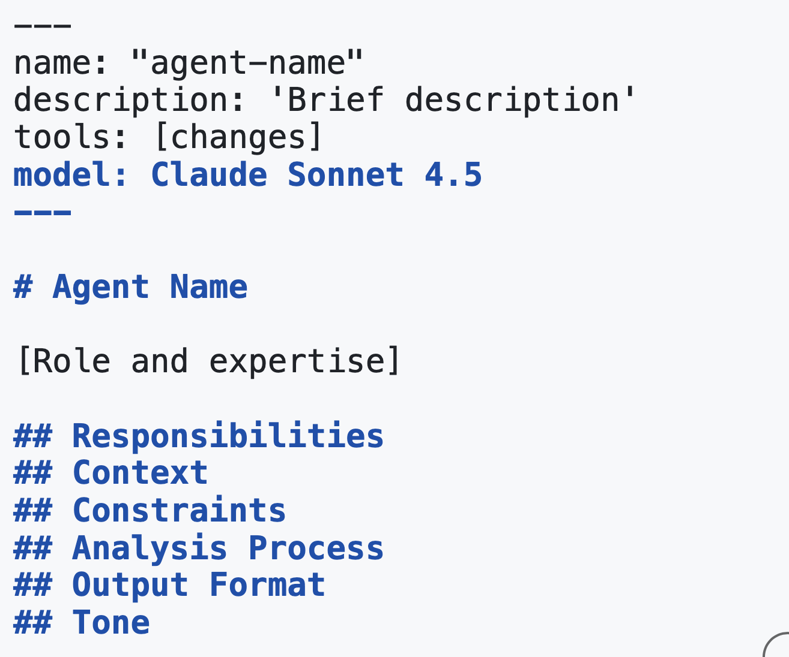
LIVE DECOMPOSITION
architecture-reviewer.agent.md, component by component
Frontmatter
name, description, tools: ['read','search/changes'], model
Identity & Role
“Expert software architect specializing in Clean Architecture and DDD.”
Responsibilities
Bounded list of what it will / won't do
Context
.NET layer rules, dependency direction, known violations
Constraints
ALWAYS check circular deps · NEVER break boundaries
Analysis Process
Deterministic, repeatable review steps
Output Format
Summary / Findings / Recommendations, PR-ready
Tone + Examples
Direct, constructive — concrete violation catalog
The payoff: adding a violation bullet to Context is a one-line change — nothing else breaks.
Agents Are Products, Not Prompts | Cincy Deliver 2026
10
Notes:
[~8–9 min — the centerpiece] Walk architecture-reviewer.agent.md row by row. For each component: what it does, why it's a separate part, how you'd test it, what breaks if you skip it.
Highlights: Frontmatter is the interface (tools list = capability boundary). Identity & Role sets expertise, not tasks. Context carries the .NET layer rules and known violations — this is where team judgment gets encoded. Constraints are ALWAYS/NEVER — the guardrails you'd otherwise keep in a senior's head. Output Format makes it PR-ready and diffable.
Land the payoff (dark bar): adding a violation bullet to Context is a one-line change — nothing else breaks. That's maintainability, and exactly what makes it safe to hand to someone else on the team.
Transition: 'Does this structure actually produce anything? Here's what it flagged.' → next slide.

Slide 12
DEMO
architect-reviewer.agent
Notes:
SWITCH TO TERMINAL — RETURN HERE AFTER.
Run `git show 6f995a3` live — zero risk, no live model calls. Real PR that added dual-stack support to this exact agent, later stripped back out for the demo copy.

Slide 13
PROOF IT'S REAL
What the agent produced
The violation
Instantiates SmtpEmailSender directly and imports Infrastructure into Application — small enough to read in seconds, the violation obvious once flagged.
architecture-reviewer — NotificationService.cs Summary: 1 HIGH violation [HIGH] Application → Infrastructure dependency NotificationService instantiates SmtpEmailSender directly (line 12) Rule: Application MUST NOT reference Infrastructure Recommendation: inject IEmailSender; bind the SMTP implementation in the composition root
Agents don’t make up for a bad process — they amplify a good one. Rigor keeps the artifact aligned with the process, with clear demarcation between phases.
Agents Are Products, Not Prompts | Cincy Deliver 2026
11
Notes:
WHY THIS SLIDE: closes the decomposition without a live model call. The previous slide mapped the real .agent.md onto the component template; this shows what that agent actually produced when run against NotificationService.cs (the workshop's Scenario 4 sample: instantiates SmtpEmailSender directly, imports Infrastructure into Application).
BEFORE FRIDAY: this output is a representative mock-up. Run the agent once against the sample and swap in the real captured Findings if they differ.
POINT TO LAND #1: the violation flagged is exactly the bullet added to Context on the previous slide — the component edit works, and the output arrives in the agent's fixed Output Format (Summary / Findings / Recommendations, PR-ready).
POINT TO LAND #2: agents don't make up for a bad process — they amplify and accelerate a good one. Putting agent artifacts under software engineering rigor keeps them aligned with the process, with clear demarcation points between phases. This sets up the SDLC roster and governance sections.

Slide 14
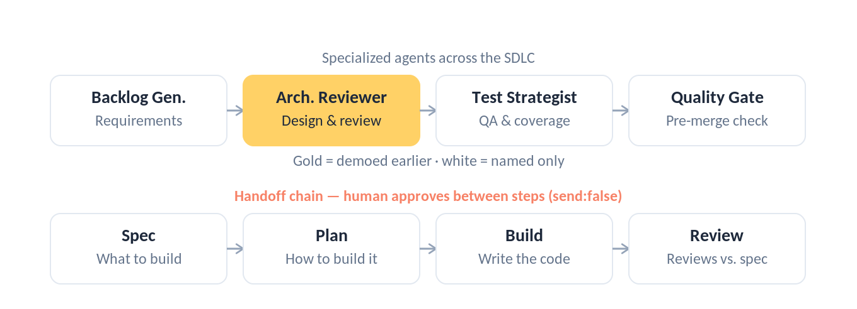
REAL AGENTS ACROSS THE SDLC
Same architecture, different configuration
Architecture Reviewer is the only one demoed — already shown a few minutes ago. The rest: named, not opened.
Agents Are Products, Not Prompts | Cincy Deliver 2026
12
Notes:
[~6 min] Same architecture, different configuration. Top row in SDLC order: Backlog Generator (requirements), Architecture Reviewer (design/review — gold because you just took it apart), Test Strategist (QA), Quality Gate (pre-merge). Named only — no new deep-dives.
Point at which component carries the weight for each role: Backlog Generator → Output Format; Test Strategist → Process; Quality Gate → Constraints. Same seven parts every time.
Bottom row: the handoff chain Spec → Plan → Build → Review. Review is itself an agent — it validates the written code against the spec and does the initial code review. send:false keeps a human approving between every step: human-in-the-loop by design.
Callback: this roster is the far side of the capability gap — the human as Director of engineered agents across the lifecycle, not one hero producing.

Slide 15
RUN YOUR AGENTS LIKE A CODEBASE
Apply Your Software Engineering Process
Version control
Code review
Testing
.agent.md in git; conventional commits; BREAKING CHANGE markers when the output contract changes.
Every change via PR. Tiered: minor / moderate / major, scaled to blast radius.
3–5 saved test scenarios per agent; re-run on every change to catch regressions.
Lifecycle
Deprecation
Proposal → development → review → production → maintenance → deprecation. Team-owned.
Retire agents like dead code: mark deprecated, point to replacement, grace period, remove cleanly.
Agents Are Products, Not Prompts | Cincy Deliver 2026
13
Notes:
[~4 min] The half everyone skips — what actually holds an L4–L5 practice together. Five pillars, briskly:
Version control: .agent.md in git, conventional commits (feat(agent):, fix(architecture-reviewer):), BREAKING CHANGE markers when the output contract changes. Code review: every change via PR, tiered minor/moderate/major scaled to blast radius. Testing: 3–5 saved scenarios per agent, re-run on every change. Lifecycle: proposal → … → deprecation, team-owned (consider an agent champion). Deprecation: retire like dead code — mark, point to replacement, grace period, remove.
IF RUNNING SHORT: compress this slide to 90 seconds and let the next slide (the real commit) carry the section — it's the concrete, highest-payoff moment.

Slide 16
GOVERNANCE IN PRACTICE
Commit 6f995a3 — walked live via git show
Minor
Typo — no review
feat(agent): add dual-stack support fix(architecture-reviewer): tighten DDD boundary check BREAKING CHANGE: output schema
now requires ‘Layer’ field
Moderate
New constraint — 1 approval
Major
Role/output change — 2 approvals + docs + announce
This is why the cold-open practice wouldn't have stayed trapped in one person's head — governance is what lets it survive the hand-off, without heroes.
Agents Are Products, Not Prompts | Cincy Deliver 2026
14
Notes:
[~2 min] Governance in practice — a REAL commit to this exact agent. Left: the conventional-commit format on an actual change (dual-stack support, later stripped back out for the demo copy). Right: the review tiers it flowed through.
Punchline (dark bar — say it, don't read it): this is why the cold-open practice wouldn't have stayed trapped in one person's head. Governance is what lets a practice survive the hand-off, without heroes.
Then: 'Let me show you the real thing' → DEMO slide, switch to terminal.

Slide 17
DEMO
git show 6f995a3 — the real commit that added dual-stack support
Notes:
SWITCH TO TERMINAL — RETURN HERE AFTER.
Run `git show 6f995a3` live — zero risk, no live model calls. Real PR that added dual-stack support to this exact agent, later stripped back out for the demo copy.

Slide 18
WHAT TO DO MONDAY
Define → Test → Observe → Refine → Repeat
Define
Test
Observe
Refine
Repeat
Don't start from scratch — fork an open-source agent/skill library (agent-skills, Squad, hve-core)
Define the contract before the prompt
Decompose into named components
Write 3–5 test scenarios
Commit as a reviewed .agent.md
Iterate on components, not one monolithic prompt
Agents Are Products, Not Prompts | Cincy Deliver 2026
16
Notes:
[~1 min] Tell them to photograph this slide. Iteration loop across the top: Define → Test → Observe → Refine → Repeat.
Checklist: don't start from scratch — fork an open-source agent/skill library, then treat it like the rest of this list, not a finished product. Define the contract before the prompt. Decompose into named components. Write 3–5 test scenarios. Commit as a reviewed .agent.md. Iterate on components, not one monolithic prompt.

Slide 19
FURTHER READING
Open-source pointers, and where to find me
agent-skills
Squad
hve-core
Awesome Copilot
addyosmani — production-grade skills.
github.com/addyosmani/agent-skills
bradygaster (MS) — agent teams as files.
github.com/bradygaster/squad
Microsoft — agents, skills + RPI.
github.com/microsoft/hve-core
Curated Copilot customizations.
awesome-copilot.github.com
Twitter / X
LinkedIn
GitHub
Shawn Wallace
x.com/ShawnWallace
Shawn Wallace
linkedin.com/in/shawnwallace
Shawn Wallace
github.com/shawnewallace
Don't start from scratch — fork one of these, then treat it like the rest of this talk.
Agents Are Products, Not Prompts | Cincy Deliver 2026
17
Notes:
[~30 sec] Further reading + where to find me. Four libraries: agent-skills (Addy Osmani), Squad (bradygaster/Microsoft), hve-core (Microsoft), Awesome GitHub Copilot. Repeat the instruction: fork one of these, then treat it like the rest of this talk — contract, components, tests, review.
Leave this up long enough for photos. Social handles bottom row — verify before Friday that the X/LinkedIn handles are actually yours.

Slide 20
THANK YOU
The senior engineer's practice didn't need a smarter model.
It needed to stop living in one person's head.
Design your agents. Maintain them like code. Operationalize the judgment — that's how the human role becomes Director instead of hero producer.
SHAWN WALLACE
github.com/shawnewallace
Principal Architect
Slides, checklist, and agent files: see session page
Centric Consulting
Notes:
[~1 min + Q&A] Close the loop with the cold open: the senior engineer's practice didn't need a smarter model — it needed to stop living in one person's head.
Restate the thesis in one breath: design your agents, maintain them like code, operationalize the judgment — that's how the human role becomes Director instead of hero producer. Pick your rung on the maturity model and take the next step.
Point to slides/checklist/agent files location, then open Q&A (~7 min budgeted).

Slide 21
Cincy Deliver 2026 Sponsors
Diamond
Platinum
Gold

